Slide 1
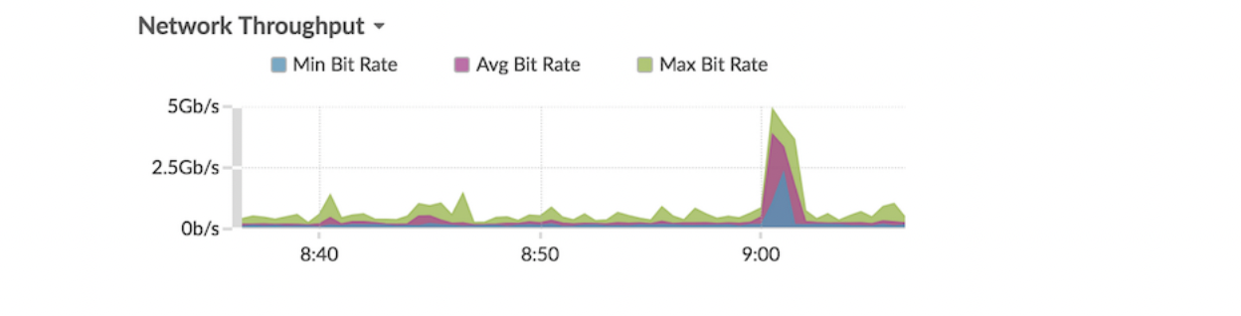
Charts (descriptive)
Area chart
Metric data is displayed as data points over time connected by a line, with the area between the line and the x-axis filled in with color. If your chart contains more than one metric, data for each metric is displayed as an individual line, or a series. Each series is stacked together to illustrate the cumulative value of the data.
-This chart supports detection markers , which indicate detections associated
with chart data.
-Machine learning detections require a connection to ExtraHop Cloud Services .
Depth to ExtraHop :
https://docs.extrahop.com/8.9/eh-cloud-services/#connect-to-extrahop-cloud-services

Slide 2
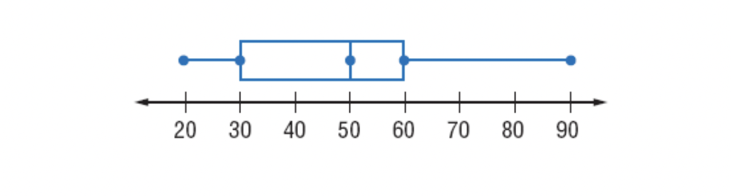
Box Plot chart
A box plot is a chart that summarizes data by dividing it into four parts (quartiles).
Box plot shows the spread (range) and median (middle) of the data.

Slide 3
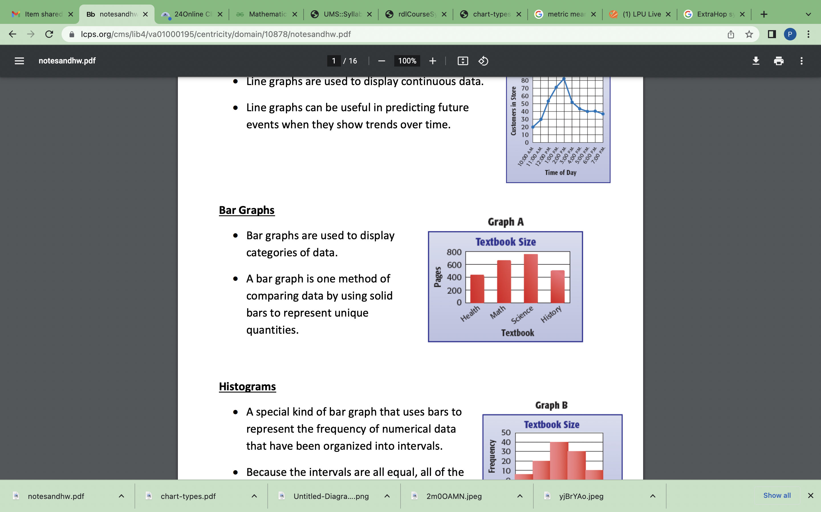
Bar chart
The total value of metric data is displayed as horizontal bars. Select the bar chart when you want to compare the data for more than one metric

